Slide 1


How to really use Google Gemini 1.5

Slide 2

Getting Google Gemini 1.5

Slide 3
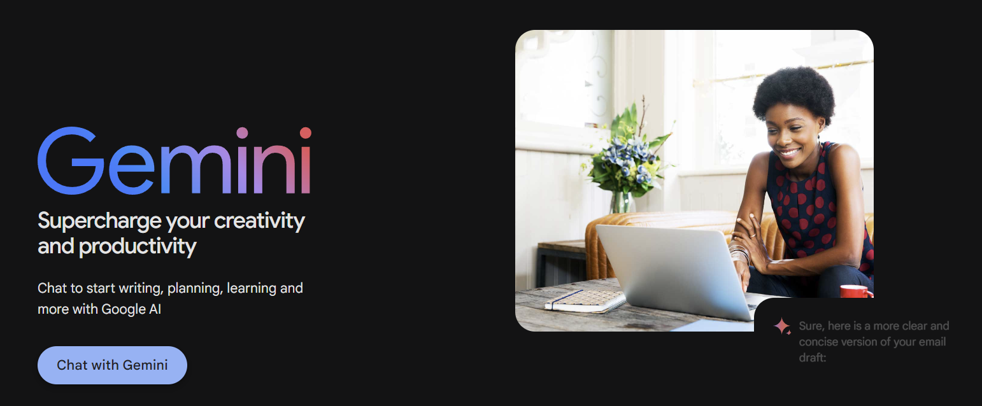
Notes:
https://gemini.google.com/

Slide 4
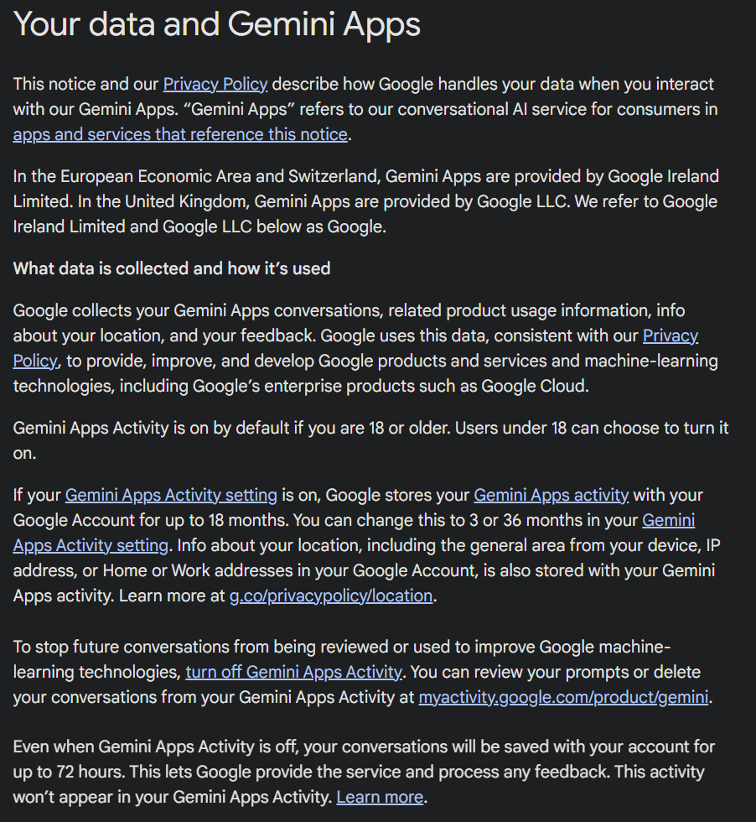
Data collection

Slide 5
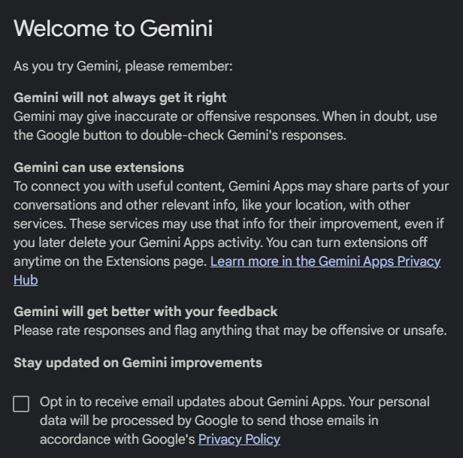

Slide 6
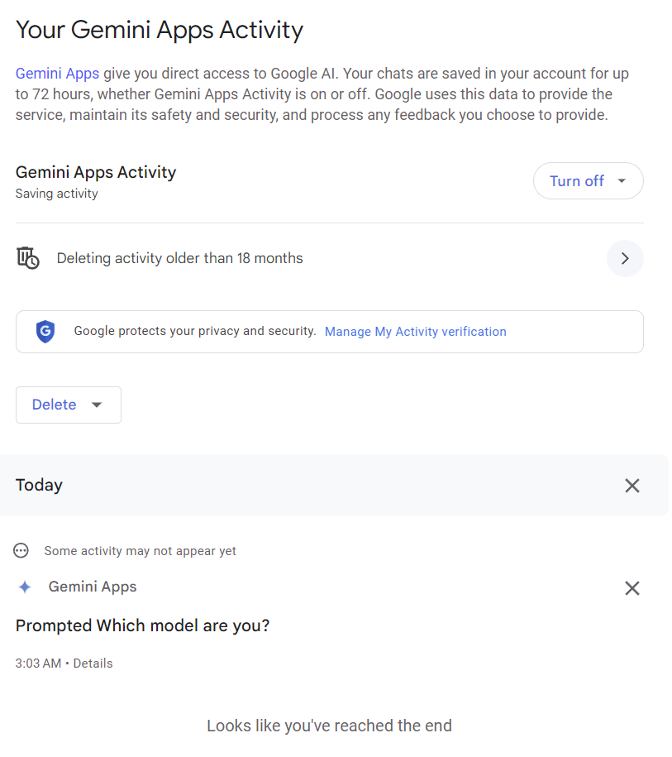
Demo: Understanding Apps Activity

Slide 7
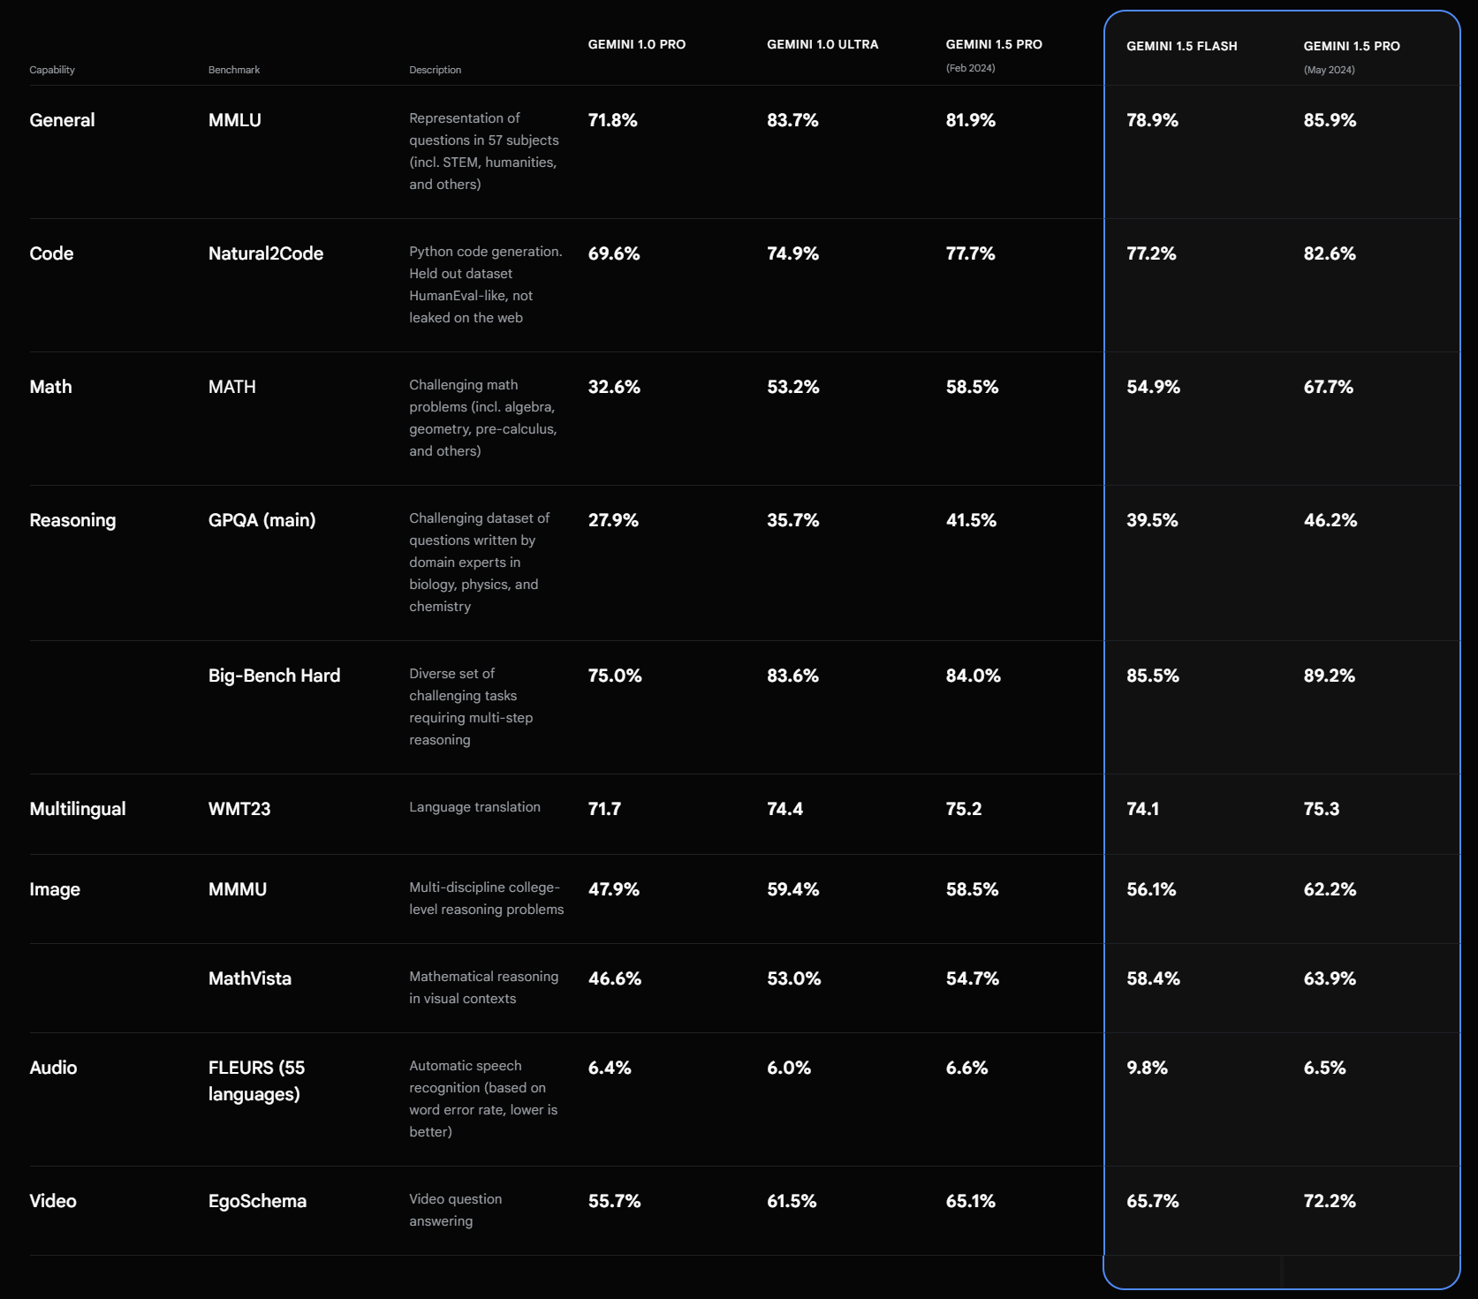
Gemini Flash vs Pro
Notes:
https://deepmind.google/technologies/gemini/flash/
https://storage.googleapis.com/deepmind-media/gemini/gemini_v1_5_report.pdf

Slide 8
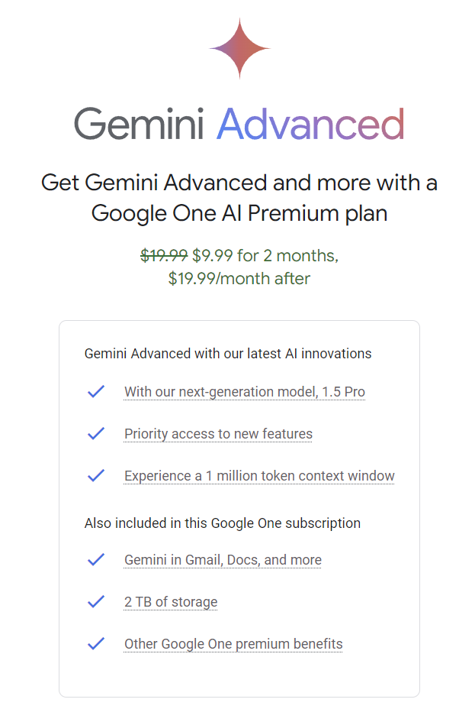
Google One AI Premium plan
Notes:
https://one.google.com/explore-plan/gemini-advanced

Slide 9
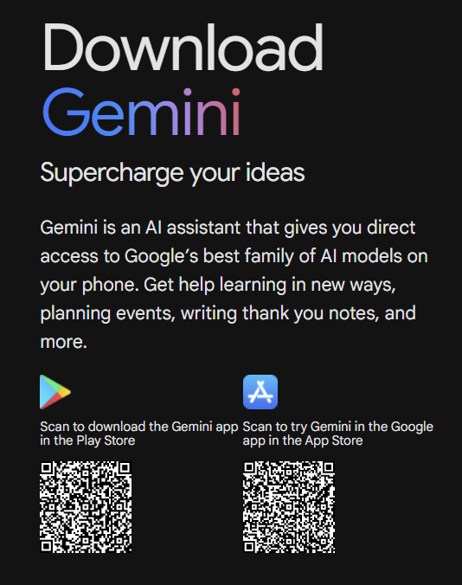
Get the mobile App
Notes:
https://gemini.google.com/app/download

Slide 10

Why Google Gemini 1.5?

Slide 11
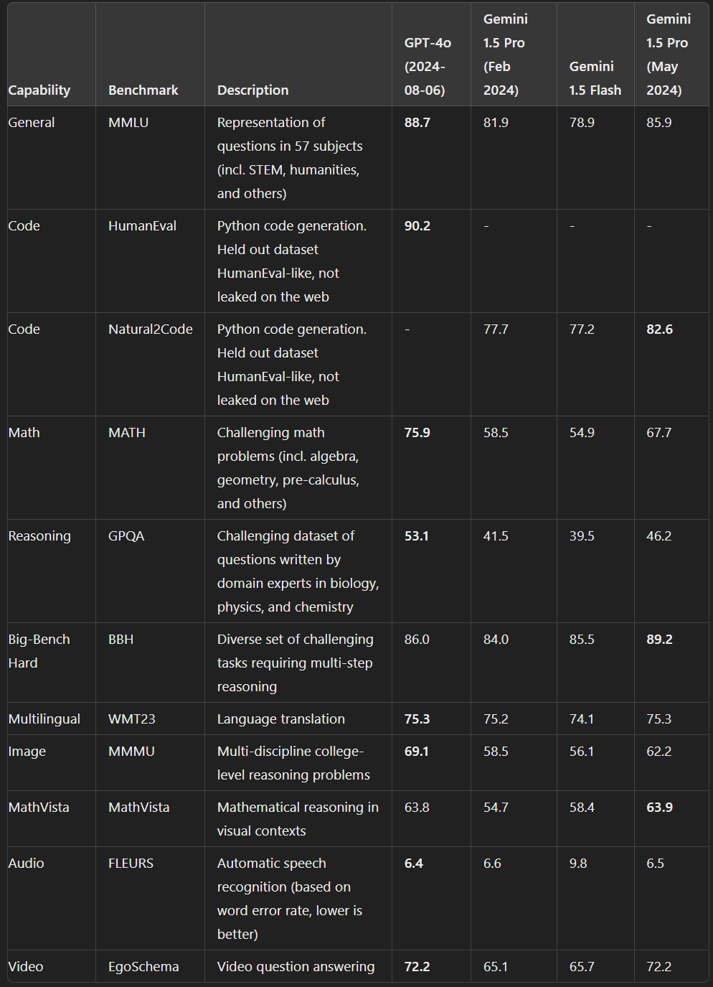
Better than ChatGPT?
Notes:
https://deepmind.google/technologies/gemini/flash/
https://github.com/openai/simple-evals?tab=readme-ov-file#benchmark-results
1. GPT-4o Benchmarks:
- https://community.openai.com/t/list-of-fresh-gpt-4o-benchmarks-please-add/24525/7
- https://github.com/suzgunmirac/BIG-Bench-Hard
- https://www.scribbledata.io/gpt-4o
- https://paperswithcode.com/sota/code-generation-on-humaneval
2. Gemini 1.5 Pro Benchmarks:
- https://ar5iv.labs.arxiv.org/html/2403.05530v2
- https://storage.googleapis.com/deepmind-media/gemini/gemini_v1_5_report.pdf
- https://www.evolution.ai/gemini-15-report
3. Gemini 1.5 Flash Benchmarks:
- https://deepmind.google.com/gemini
- https://blog.google/gemini-1-5-flash
- https://developers.googleblog.com/2024/05/gemini-1-5-pro-and-flash-ga.html
- https://ar5iv.org/pdf/2403.05530.pdf

Slide 12
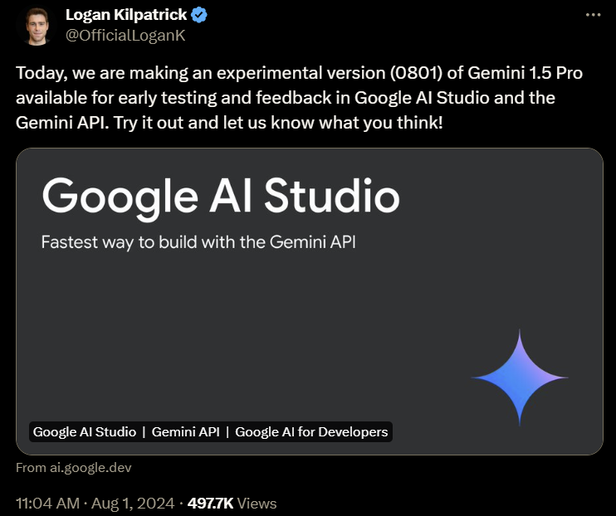
There is a new version of Gemini 1.5 pro
Notes:
https://x.com/OfficialLoganK/status/1819041453978357899

Slide 13
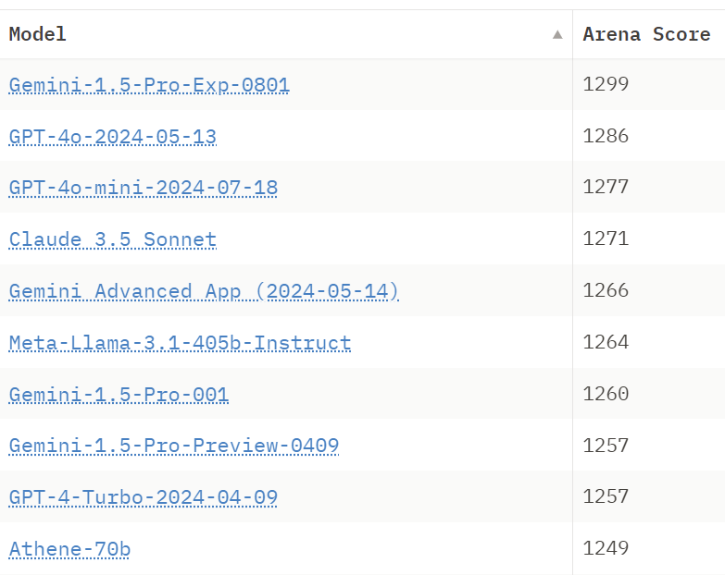
The Jury is Still Out
Notes:
https://huggingface.co/spaces/lmsys/chatbot-arena-leaderboard

Slide 14

Video
Notes:
https://storage.googleapis.com/deepmind-media/gemini/gemini_v1_5_report.pdf

Slide 15

Audio
Notes:
https://storage.googleapis.com/deepmind-media/gemini/gemini_v1_5_report.pdf

Slide 16


